Slide 1
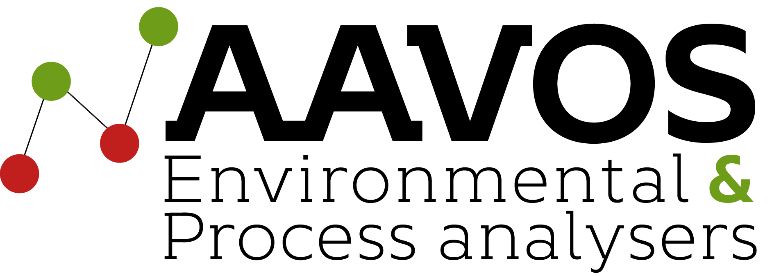

Agriculture &
Livestock
Air Quality Monitoring
Approach & Solutions
Air Quality Solutions
Powered by AI & Green Technology
Notes:
Opening slide. Introduce AAVOS as official distributor of Scentroid technology for agriculture and livestock air quality monitoring.

Slide 2



The Challenge
Why Air Quality Monitoring is Critical for Agriculture & Livestock
Indoor Health Risks
Community Complaints
Regulatory Pressure
Indoor air contaminants directly affect the health of both livestock and workers — reduced productivity, illness, and safety hazards.
Outdoor pollutants create nuisance complaints in surrounding communities. Unresolved odour issues escalate quickly.
Government intervention follows unaddressed pollution. Proactive monitoring avoids costly fines and forced shutdowns.
Emissions from farms outweigh all other human sources of fine-particulate air pollution in much of the US, Europe, Russia, and China — Columbia Climate School, 2016
Notes:
Key challenges: indoor health, community relations, and regulatory compliance. Position AAVOS monitoring as a proactive, not reactive, solution.

Slide 3
AAVOS Monitoring Approach
A comprehensive two-layer strategy for complete indoor & outdoor coverage
🏭 Stationary Equipment
🚁 Odour Patrol
CTmini & AQmini
Continuous 24/7 monitoring of indoor and outdoor air quality around your facility.
• Indoor livestock/worker safety
• Outdoor perimeter monitoring
• Real-time pollutant levels
• Wireless network of sensors
Mobile & Aerial Monitoring
Developed in 2015, used in Canada, UAE, USA, Italy, Chile and more.
• Hotspot detection across large areas
• Granular spatial & temporal data
• SM100i olfactometer + TR8 Odotracker
• DR2000 drone flying laboratory
Together: Full facility coverage — indoor, outdoor, near & far
Notes:
Explain the two-pillar monitoring strategy. Stationary equipment provides continuous baseline data; Odour Patrol adds mobile flexibility for hotspot identification.

Slide 4
Pollutants Monitored
Agriculture & livestock facilities emit a complex mix of gases and particulates requiring simultaneous monitoring
NH₃
H₂S
CH₄
N₂O
CO₂
Ammonia
Hydrogen Sulfide
Methane
Nitrous Oxide
Carbon Dioxide
PM
VOCs
NO
O₃
H₂S
Particulate Matter
PM1, PM2.5, PM10
Volatile Organic
Compounds
Nitric Oxide
Ozone
Organic Sulfides
& Disulfides
+ Exhaust Fumes • Aromatic Compounds • Criteria Air Pollutants (CAP) • and more
Notes:
Comprehensive pollutant list. Emphasise that AAVOS monitors all these simultaneously — no need for multiple vendors.

Slide 5
Monitoring Devices
A wide range of tools for every monitoring need — from fixed stations to aerial drones
Perimeter
Indoor
Perimeter
Aerial
CTmini
AQmini
CTair
DR2000
Particulate Matter Monitor
Indoor Air Quality
Compact Network Analyzer
Aerial Flying Lab
Highly accurate PM1, PM2.5, PM4, PM10 plus Temperature & RH
High-powered, cost-effective IAQ monitoring for enclosed spaces
Wireless, compact multi-pollutant analyzer — deployable as a sensor network
Conducts ambient measurements in hard-to-reach places via drone
Mobile
Mobile
Mobile
Support
SM100i
TR8+
US20
Weather Station
Intelligent Olfactometer
Pollutracker
Urban Scanner
Meteorological Data
Auto-screens panelists; eliminates guesswork from field olfactometry
Portable, multi-sensor tool measuring up to 10 chemicals simultaneously
Vehicle-based monitor for community impact assessment along roads
Tracks temperature, humidity, pressure, wind speed and precipitation
Notes:
Walk through each device category. Typical agriculture/livestock facility requires 4–6 stationary monitors positioned strategically around the perimeter.

Slide 6





SIMS3
Powered by
Artificial Intelligence
Sensor Information Management System
Plume Detection
AI-powered software that transforms raw sensor data into actionable intelligence — automatically.
Track emission spread in real time
Temporal, Statistical, AQI & Heat Map analytics
Complaint Justification
Auto-classify complaints as justified / not justified / pending
Real-time odour complaint management & justification
Event triangulation to pinpoint unknown odour sources
Source Triangulation
Pinpoint unknown odour sources via back-trajectory analysis
Sensitive receptor tracking with odour unit/second values
Atmospheric dispersion modelling (AERMOD)
Predictive Alerts
AQI threshold alerts before breaches occur
Automated weekly, monthly & annual reports
Notes:
SIMS3 is the brain of the entire monitoring system. Emphasise the AI-powered automation — clients do not need to manually analyse data.

Slide 7
Odour Complaint Management
SIMS3 handles the entire complaint workflow automatically — from receipt to legal justification
JUSTIFIED
PENDING
NOT JUSTIFIED
Complaint automatically categorised as justified. Emission source identified, corrective action required.
Recorded and flagged for further analysis. Triangulation initiated to determine contribution.
Recorded but categorised as unjustified. Data archived for regulatory evidence purposes.
Triangulation of Unknown Sources
SIMS3's Event Triangulation mode pinpoints unknown odour source locations using ambient monitoring data and back-trajectory analysis. Sources are identified down to their contribution in odour units per second. This is admissible evidence for regulatory defence.
Notes:
Key selling point: AAVOS turns complaints into evidence. The system automatically classifies complaints and provides data that can be used in regulatory defence.

Slide 8



Complete Emission Inventory Services
Beyond hardware — AAVOS provides expert services for a complete compliance picture
Environmental Impact Assessment
Atmospheric Dispersion Modelling
Comprehensive site overview with a qualified team. Olfactometric measurements, ISO 17025 analytical lab, optional AERMOD dispersion modelling.
Determine the severity and extent of pollutant/odour emissions. Processed using the US-EPA approved AERMOD suite.
Odour Analysis
Direct Aerial Sampling
Laboratory determination of odour concentration per EN13725:2022, ASTM E679-04, VDI 3881, and other international standards.
Drone-based analyzers collect residual gases high above your facility. Full on-site analysis by our air and odour experts.
Also available: Perimeter Monitoring • Odour Patrols • Aerial Monitoring • New Source Identification • Complaint Database • Regulatory Reports
Notes:
AAVOS is not just hardware. We provide end-to-end services including lab analysis, dispersion modelling, and regulatory reporting.

Slide 9
Proven Track Record
Global references across agriculture, livestock, and related facilities
Peel Region | Ontario, Canada
Haya Water | Oman
Metro Vancouver | Vancouver, Canada
Odour Management Plan, SIMS3 facility-wide integration, DR2000 ambient monitoring, SL50 perimeter, dispersion modelling
Training workshop, regulator training, odour monitoring equipment installation, software modelling
Odour regulation & field inspection protocols, training for environmental engineers, odour measurement workshops
Al Warsan WWTP | Dubai, UAE
Marafiq WWTP | Saudi Arabia
Chicago Wastewater | Chicago, USA
Odour sampling & olfactometric analysis, emission inventory, dispersion modelling, complaint management installation
Full plant audit, odour sampling, health & safety analysis, dispersion modelling, monitoring device commissioning
Emission inventory, odour source identification, olfactometric analysis, community impact reporting, perimeter monitoring
Notes:
References demonstrate global expertise. Many more projects available on request. Position AAVOS as the regional partner backed by proven international technology.

Slide 10

Why Choose AAVOS?
Your local partner for world-class air quality monitoring technology
Proactive Compliance
End-to-End Solution
AI-Powered Platform
Global Proven Technology
Stay ahead of regulations — never face government intervention unprepared
Hardware, software, lab services and reporting — one partner, one workflow
SIMS3 automates analysis, complaint handling, and reporting 24/7
Deployed in 20+ countries; backed by ISO 9001:2015 certification
Ready to get started?
Contact AAVOS today for a site assessment and tailored monitoring proposal
Notes:
Close slide. Summarise AAVOS's value proposition: local access to global-grade technology, full-service delivery, and regulatory protection.

